Slide 1
3 Circles
Gospel Presentation

Slide 2
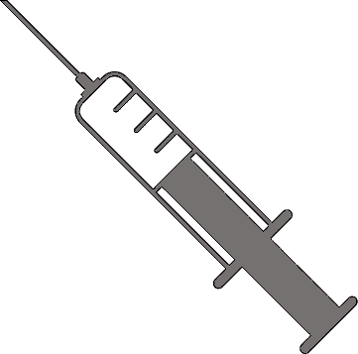
DEATH
SIN
Turn

