Slide 1
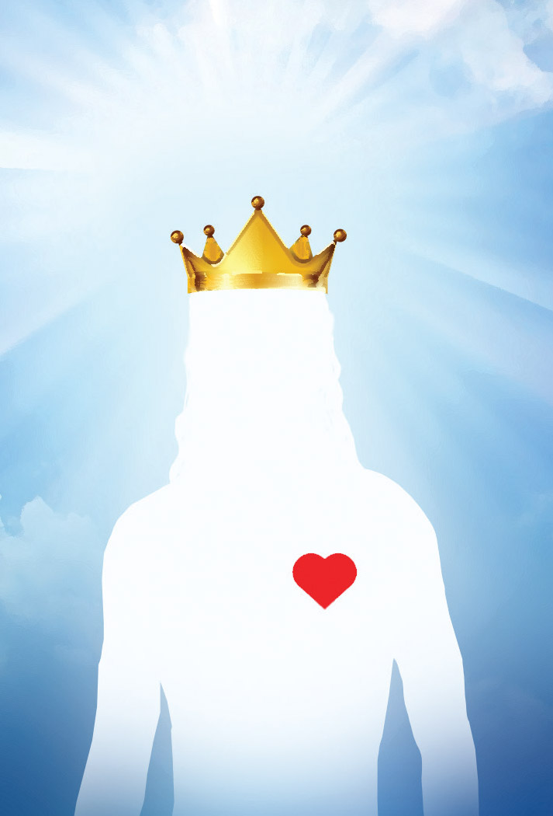
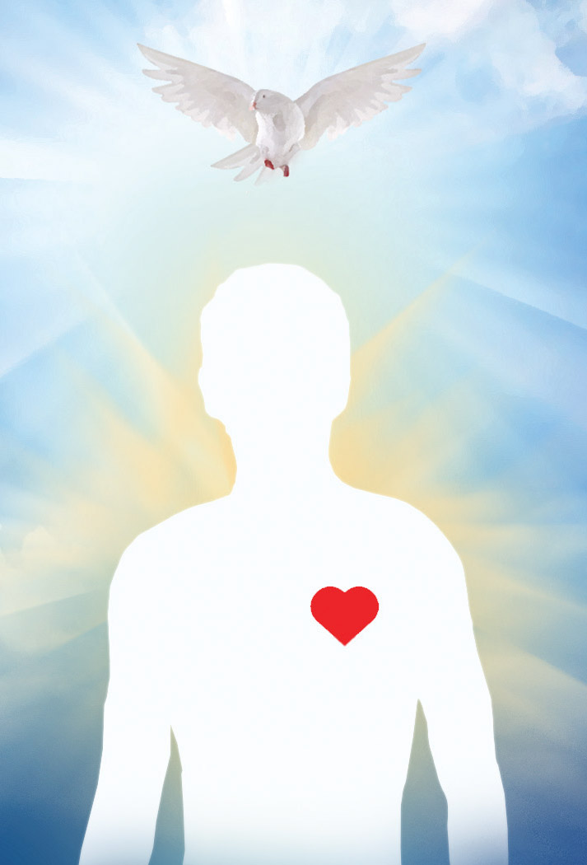
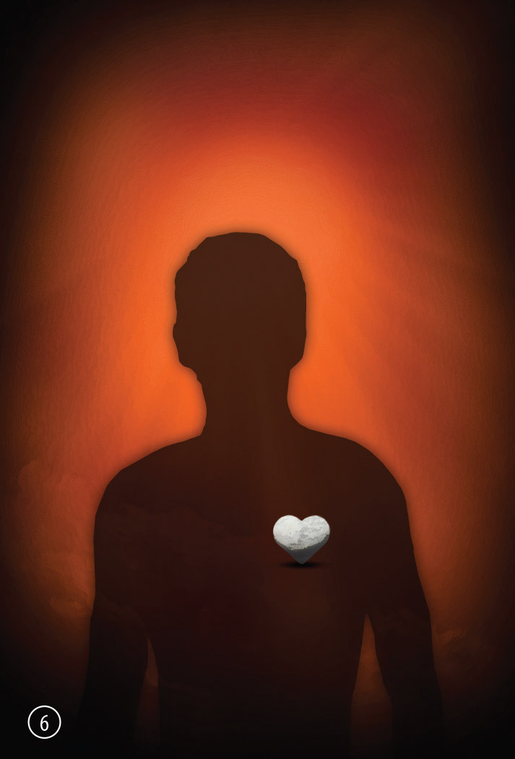
TLR Witness Cards Presentation
Notes:
let's play a simple (game).

Slide 2
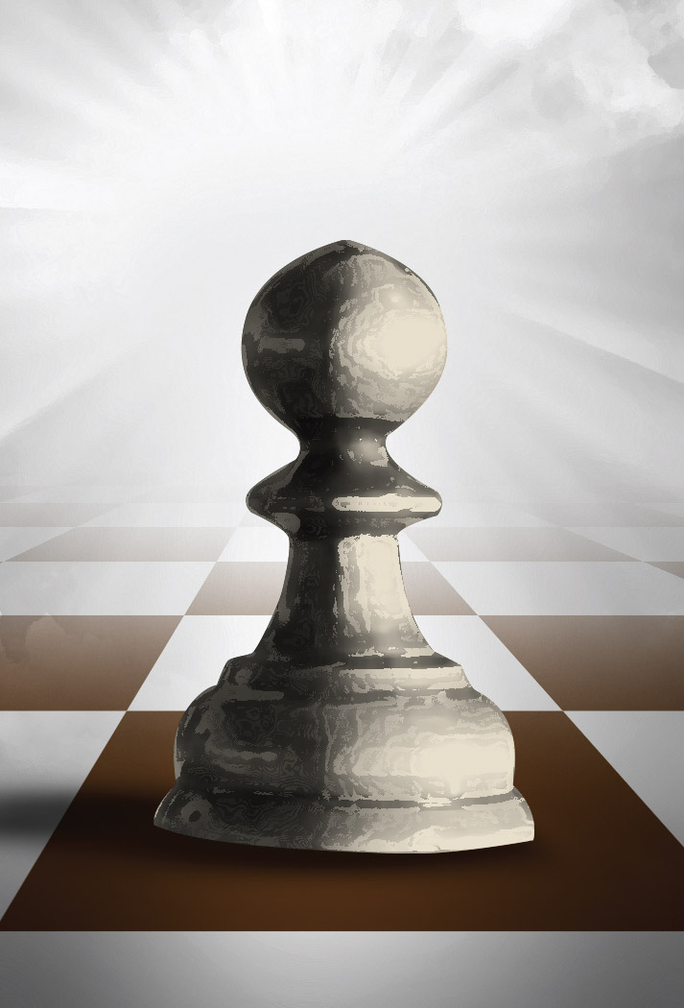
Chess
1
In The Beginning
Notes:
let's play a simple game.
It can be any game like chess or checkers, so in the game (you move once), (I move once), (you move), now it's my turn, (I move).
I really want to win this game, so, instead of one move, I will do (three moves) at once. Am I allowed to do this? No, of course not, because there are rules!

Slide 3
Chess
1
In The Beginning
Notes:
With God there are also rules. (God) made His first move, He created heaven and earth, He created man, and He created everything perfect. He said to man, I want you to obey me, if you don't obey me, you will surely die.
(Then man moved), man made a bad move, Man didn't listen to God, and because man disobeyed God, man needed to die. God cannot change His mind because that would make Him a liar.
But God didn't want man to die, so He had a solution, He (sent His son) Jesus Christ, that was His move, and Jesus Christ became a real man, He took the punishment for you and for me.
So, if you look now, God moved, man moved, God moved again. Whose move is it now? Yes, it's our move, (we need to move).

Slide 4
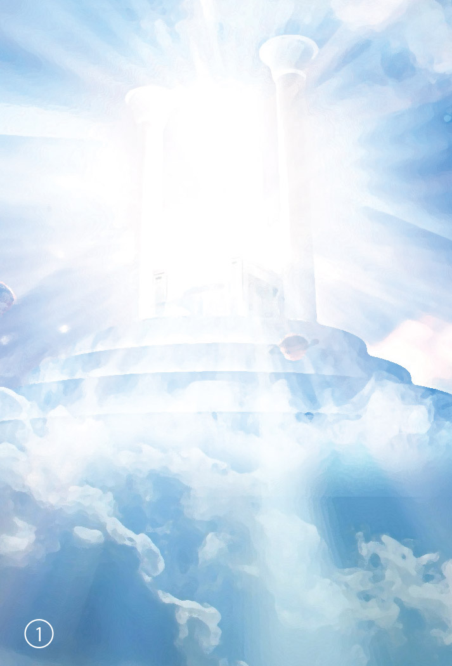
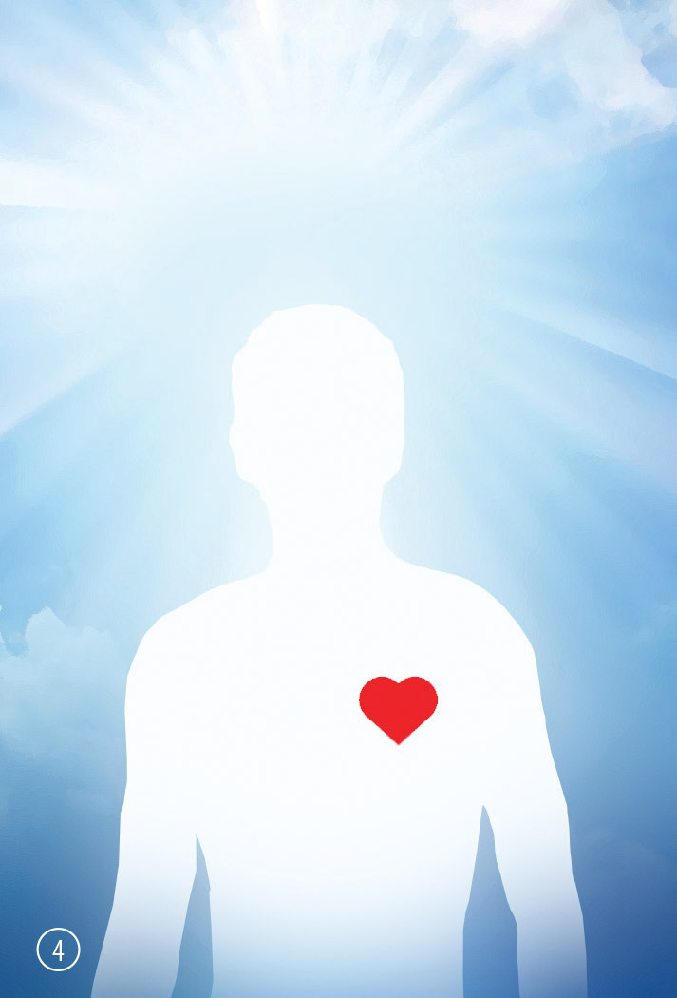
God With Man In The Garden
2
In The Beginning
Notes:
Let's start from the beginning. God created heaven and earth, and He (created man), and God had fellowship with man. They walked together, they talked together, man was open to God, everything was good.

Slide 5
2 Trees 1 Rule
3
In The Beginning
Notes:
God also created a garden, and in that garden, there was a (tree of life), and the (tree of the knowledge of good and evil). God said, you can eat from every tree except from the tree of the knowledge of good and evil, if you eat from that tree, you will surely die.
God gave man free will; He did not make two robots. He gave them free will so that they can choose to love Him and have a relationship with Him.

Slide 6
Became Closed To God
4
In The Beginning
Notes:
Man was deceived, and they (ate from the tree), as soon as they did, they became closed, they became in darkness, they were separated from God. They had a stoney heart, and God said because you ate of the tree of the knowledge of good and evil, you need to (go out of this garden) because if you eat from the tree of life, you will live forever in sin, God had other plans.

Slide 7
Broken World Far From God
5
In The Beginning
Notes:
Now man was in the world, and they had children, Cain and Abel, as you can see, they're also in darkness, they have a stoney heart. When a child is born, you don’t need to teach them to lie, they will lie automatically, and that's the sinful nature. So, (Cain) killed Abel, and there was the first murder.

Slide 8
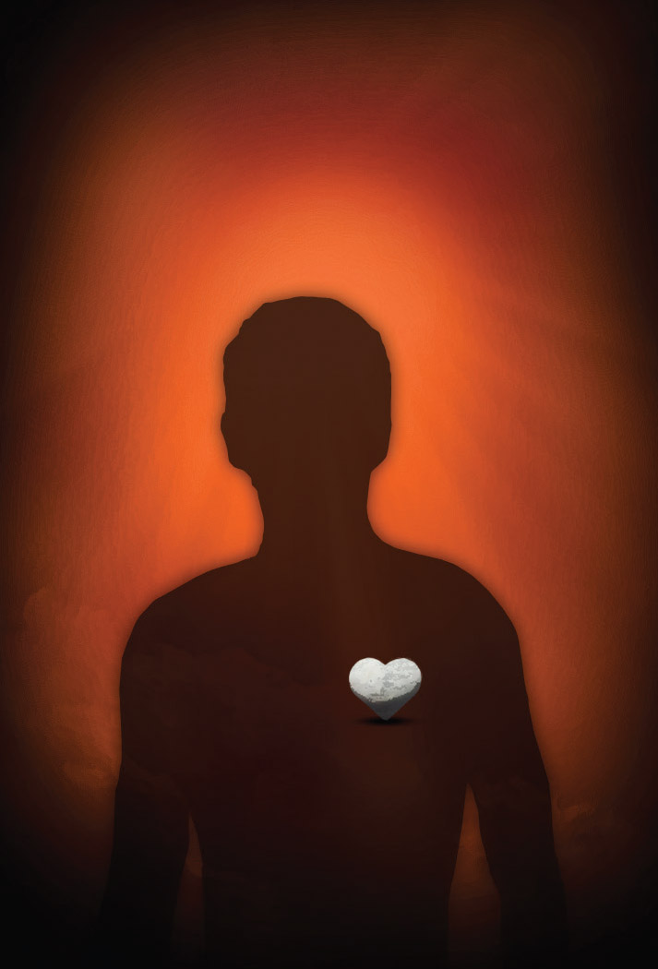
Broken World Far From God
5
In The Beginning
Notes:
More and more people populated the earth, and they were all sinners. They were (lying), they were (stealing), they were (raping), and (killing). God finally regretted that he made man.
There was only one man who was righteous in his eyes, and it was (Noah).
God said to Noah, Noah, I want you to make a big boat because I'm going to wash the earth clean of all that sin, and Noah in faith built that boat, and when he was finished, he went in with his family, and God sent a flood.
(God washed) all the sin from the face of the earth. This is a strong picture of baptism, where the water washes away all the sins, and man is saved by the ark, which is a representation of Jesus through the water.

Slide 9
Broken World Far From God
5
In The Beginning
Notes:
Noah came out of the Ark with his three sons. Noah liked wine, and he got drunk, and his (youngest son) saw him laying naked on a bed drunk, and he made fun of him. Now you can see that God took sin out of the world, but sin was still in man.

Slide 10
Problem With Comparing
6
Penalty Of Sin
Notes:
The world got populated, and it started all over again, all were sinners.
Sometimes people compare themselves with others and think they are not that bad after all. A person who (lies) may look at a person who steals and say, “At least I don’t steal things from people’s houses; I’m not that bad.” A person who (steals) may look at a rapist and say, “I’m not that bad because that person does terrible things to women.” A (rapist) may look at a murderer and say, “I’m not that bad because at least I don’t kill anyone.”

Slide 11
Problem With Comparing
6
Penalty Of Sin
Notes:
But we are not a (standard), we should compare ourselves with God, God is the standard, and he says you cannot lie, and if you broke one of the laws you are guilty of breaking them all.

Slide 12
Am I A Good Person
7
Penalty Of Sin
Notes:
Imagine this: a person driving a car goes through a red light. A traffic officer stops him. The man says to the officer, "I'm really sorry," and the officer says, "You've broken the law; you must pay the fine." The man says, "But I've driven through ten thousand green lights. Can't you let me off this one red light?" The officer says, "No, you need to go through those green lights, and that's right and good. But when you go through a red light, that's breaking the law, and you must pay the fine." It's like that with God. We may do many good things where God expects us to do good things, but He also expects us not to break His law. When we break the law, we have to face the punishment for it.

Slide 13
Not Just What But Who
8
Penalty Of Sin
Notes:
What if I lie to a little (child), maybe the child will cry, but if I give them an ice cream, the child will be happy again. But if I lied to (my spouse), then I would have serious relationship problems. If I lied to (my boss), he could fire me, and if I lied to (a judge) in court, he could put me in prison.
You know it's still a lie, but the (higher the authority), the bigger the consequence. So, what if I lied to (God)? Then I would deserve the highest punishment.

Slide 14
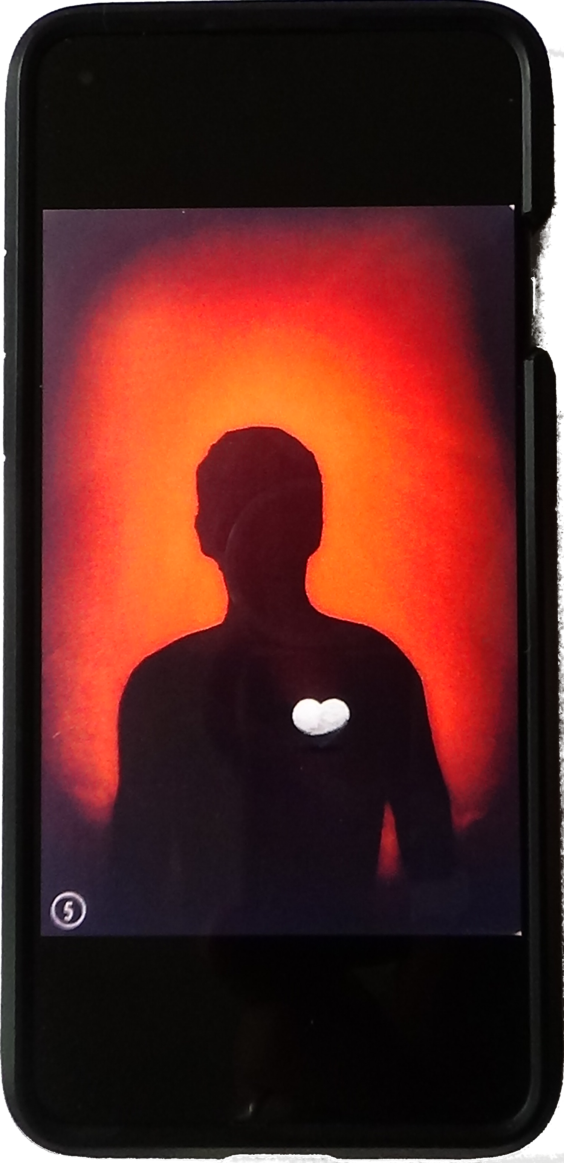
Special App
9
God’s Judgement
Notes:
Using your imagination, on my smartphone, I’ve downloaded this app where I can record five minutes of your life, I will be recording every lustful thought that you have had, I would record every time you lost your temper, every time that you said or thought anything bad, everything you've done behind closed doors, the sin that you don't want anyone to know about, and I will take that five-minute video and I will post it on (YouTube) or Facebook for everyone to see. How would you feel? If it were me, I would feel (embarrassed). Now if we feel so embarrassed in front of people who all had a five-minute video, how will we feel when we stand in front of God one day?

Slide 15
Good God Good Judge
10
Gods Judgment
Notes:
By God's standard, each person has broken God's law. God says the soul that sins will die. So, if I break one of God’s laws, I am guilty of breaking them all, when you start to realise this, you know that God (sends us all away), and puts us in hell, he’s still good, he’s still righteous. But that’s not God’s plan!

Slide 16
Sent Jesus – Like Adam
11
God Loves Us
Notes:
God made a way, he gave His son (Jesus Christ), and Jesus was born from man, so he was a real man, but he was also born from God and that made Him without sin. Jesus lived among the people and finally, when he was around 30 years old.

Slide 17
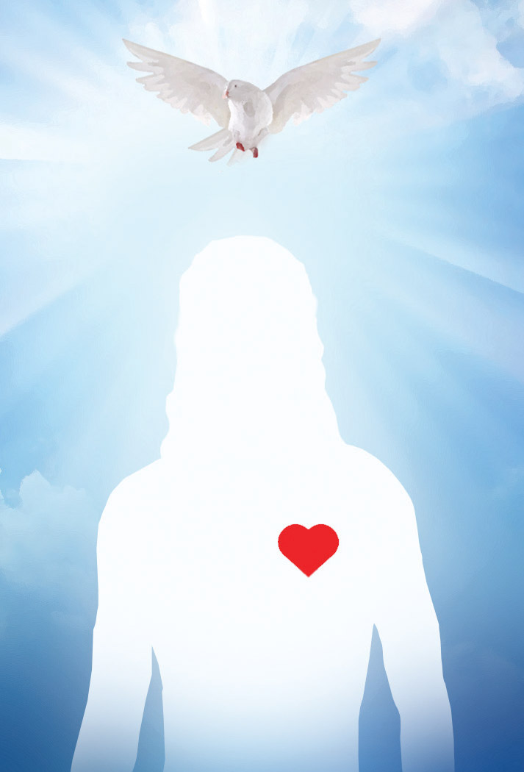
Receive The Holy Spirit
12
God Loves Us
Notes:
He went to John the Baptist, John was baptising people in water, and when Jesus went to him, John (baptised) Jesus fully underwater. When Jesus came up out of the water, the (Holy Spirit) descended on him in the form of a dove, and a voice from the Father said, “This is my Son, whom I love; with Him, I am well pleased.”

Slide 18
Message And Mission
13
God Loves Us
Notes:
Jesus went around (healing the sick), casting out demons, raising the dead, and He did all kinds of miracles.

Slide 19
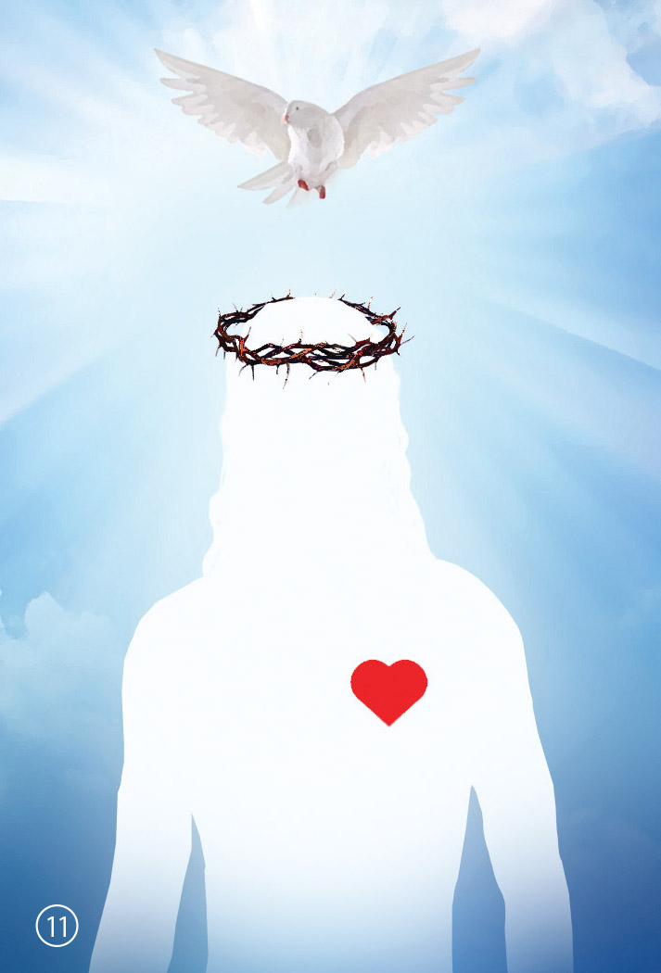
Death And Life
14
God Loves Us
Notes:
There were some (religious people) who did not like what Jesus was doing, they were preaching rules and regulations, they put rules and burdens on people. But Jesus was preaching relationship with God, he was preaching love, and the religious people falsely accused Him, they whipped Him, flogged Him, humiliate Him, and put him (on a cross), and there, Jesus gave His life, they didn't take his life, he gave his life willingly, and He (died and was buried). Three days later, Jesus rose again, death could not hold Him because He was without sin.

Slide 20
With God
15
God Loves Us
Notes:
Jesus appeared to his disciples, and he said to them, now you do like I have done, now you preach the gospel to everybody, you heal the sick, you cast out demons, you raise the dead.
I will give you the power because I will go to my Father. But I will not leave you alone, I will not leave you as orphans, I will send my Holy Spirit down.
Jesus (went to the Father), and there he sits on the right hand of the Father, and in Him has been given all power in heaven and on Earth, so how much power has Satan? Nothing, only the power we give Satan. If we let sin in, if we choose against Jesus, then he gets a hold on us.
At Pentecost, the disciples were together, and they all received the Holy Spirit, the same Holy Spirit as Jesus had because Jesus poured it out over them, and they spoke in tongues as of fire distributing on them, there was a sound of a mighty rushing wind and they were all speaking different languages.
When all the people heard them speaking, they said, what is it? And Peter explained to them, you crucified Jesus the Messiah, and when they realized that, they cried out, what shall we do, and Peter said repent and be baptised every one of you in the name of Jesus Christ for the forgiveness of your sins, and you will receive the gift of the Holy Spirit.

Slide 21
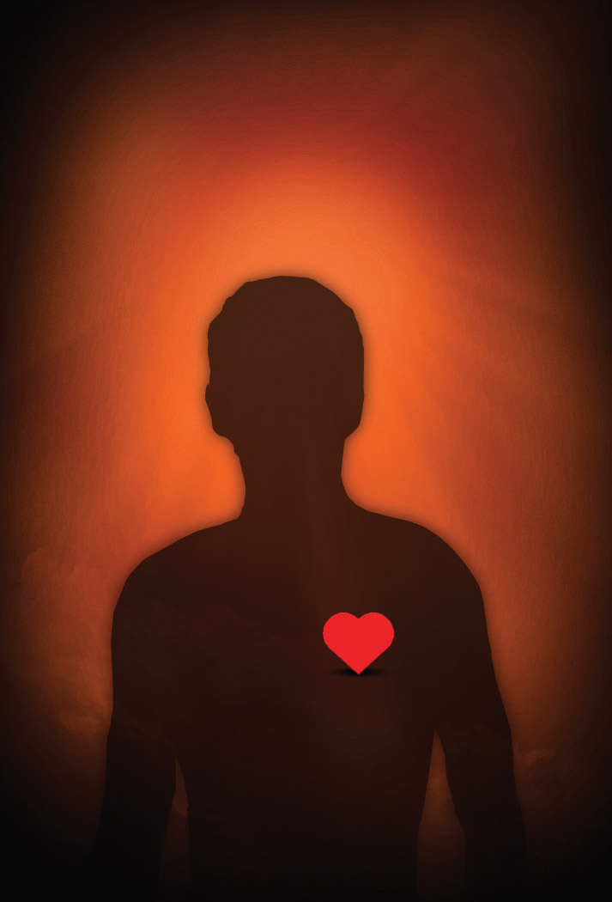
Repent, Believe, Baptism,
Holy Spirit
16
How Can We Be Saved?
Notes:
As soon as somebody (turns to Jesus), they repent. Repentance is not just saying sorry, repentance is really having that conviction in your heart, and turning
to Jesus, confessing your sins, forgiving everybody, forgiving yourself, and if you do, God does something amazing, (He takes away) that stoney heart, and gives you a heart of flesh instead.
Then you need to (go to the water), and you need to wash all that sin away, fully submerged in water, and when you come up, you are a new creation, that old nature is gone. Then there is a promise, you will (receive) the Holy Spirit.
Now we have a new disciple, and this disciple has the same calling, he needs to go around and preach the gospel.

Slide 22
What Is A Disciple?
Repent!
17
How Can We Be Saved?
Notes:
As soon as somebody wants to hear, then they sit with them, and he helps them, explains everything to them, and as soon as that person repents.

Slide 23
New Heart
18
How Can We Be Saved?
Notes:
God takes away their stoney heart and gives them a heart of flesh.

Slide 24
Buried In Baptism
19
How Can We Be Saved?
Notes:
Then this disciple will baptise that person fully in water, and when they come out, all their sins are washed away and that person has a new nature.

Slide 25
Filled With Holy Spirit
20
How Can We Be Saved?
Notes:
Then the disciple lays hands on the new disciple and prays for the Holy Spirit to come, and they baptise them in the Spirit, and this person will be filled with the Holy Spirit just like the other one.

Slide 26
Living As A Disciple
21
How Can We Be Saved?
Notes:
This is our calling, we need to go, we need to preach the gospel, we need to heal the sick, cast out demons, raise the dead because that's what Jesus commanded us. He has given us the power.

Slide 27
Outcome
22
Outcome
Notes:
Very soon, Jesus will come back to judge the living and the dead, and he will divide the sheep from among the goats, the people who obeyed Him, and disobeyed Him, and in that group of disobedient people can be people who are born again, but did not finish the race, did not want to walk on the hard road, and entering through the narrow gate.
For the people who disobeyed, He will say (depart) from me, I never knew you, and to the people who (obeyed) Him and loved Him, they will have fellowship with Him, and eat from the Tree of Life and live forever.
Now let's go back to the game.

Slide 28
Outcome
23
Chess
Notes:
(God moved), and He gave His Son. Jesus gave his life for us, and paid the price for our sin so that our relationship with God could be restored.
Now it's your turn, (when you) repent toward God and forgive everybody, (God moves) again, and He takes away the stoney heart, and He gives you a heart of flesh, now it's your move again, now you need to be (baptised) and wash away your sin, and as soon as you are baptised in water, (God will forgive) you your sin, and He will give you the Holy Spirit, and that last move, that’s (yours), you need to walk it out, you need to walk a life in faith, you need to have an active life in relationship with Jesus Christ, it's not about you any more, it's now only about Jesus.

Slide 29
Outcome
24
Where Are You?
Notes:
So where are you? (1)(Maybe you have) not having repented toward God, (2)(maybe) you have a repentant heart already, but you have never been baptised on your own faith, or you were baptised only as a symbol, or you were baptised into the membership of a church. (3)(Maybe you) were baptised but have never received the Holy Spirit, (4)(or maybe) you are fully Born Again, spirit-led and obeying the commands of Jesus.
(So), where are you?

